Slide 1
Inferential Statistics
Confidence Interval and Hypothesis Testing

Slide 2
What is Inferential Statistics?
Descriptive statistics describes and summarizes data (for example, a chart or graph).
Inferential statistics allows you to make predictions (“inferences”) from that data. With inferential statistics, you take data from samples and make generalizations about a population.
For example, you might stand in a mall and ask a sample of 100 people if they like shopping at Yellow. You could make a bar chart of yes or no answers (that would be descriptive statistics) or you could use your research (and inferential statistics) to reason that around 75-80% of the population (all shoppers in all malls) like shopping at Sears.

Slide 3
What is Inferential Statistics?
Inferential statistics use a random sample of data taken from a population to describe and make inferences about the population. Inferential statistics are valuable when examination of each member of an entire population is not convenient or possible.
Inferential statistics are concerned with making inferences based on relations found in the sample, to relations in the population.

Slide 4
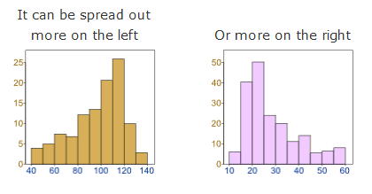
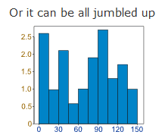
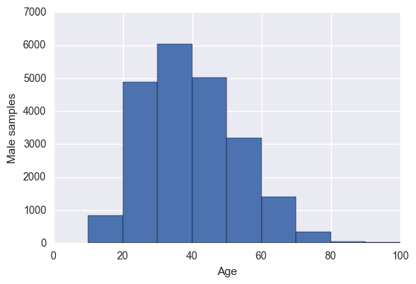
Data Distribution

Slide 5
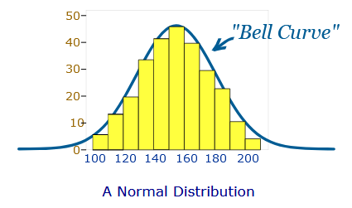
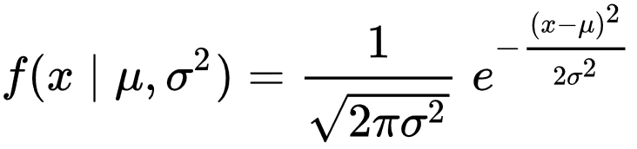
Normal Distribution
In probability theory, the normal (or Gaussian or Gauss or Laplace-Gauss) distribution is a very common continuous probability distribution
In probability theory, the normal (or Gaussian or Gauss or Laplace-Gauss) distribution is a very common continuous probability distribution
The probability density of the normal distribution is
The Normal Distribution has:
mean = median = mode
symmetry about the center
50% of values less than the mean and 50% greater than the mean

Slide 6
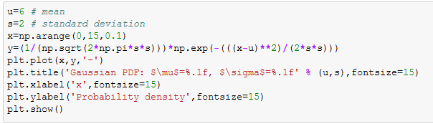
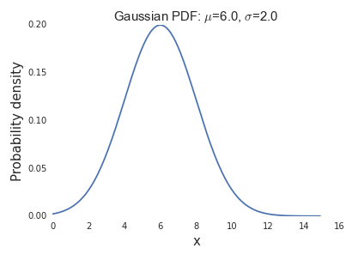
Python Code for Normal (Gaussian) Distribution

Slide 7
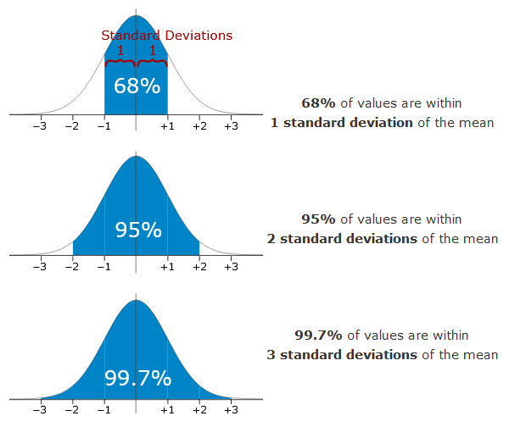
Properties of Normal Distribution

Slide 8
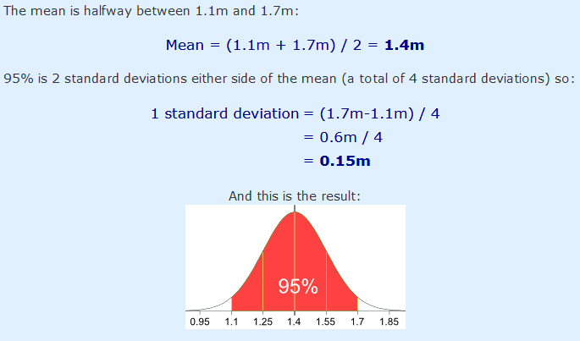
Example 1
95% of students at school are between 1.1m and 1.7m tall. Assuming this data is normally distributed can you calculate the mean and standard deviation?

Slide 9
Standard Score or “z-score”
The number of standard deviations from the mean is also called the "Standard Score", "sigma" or "z-score“
Example 2: In that same school one of your friends is 1.85m tall. Find out his z-score.
z-score (for one sample) = (x – μ) / σ = 1.85 – 1.4 / 0.15 = 3.0

Slide 10
Z-score (for multiple samples)
z = (x – μ) / (σ / √n) This z-score will tell you how many standard errors there are between the sample mean and the population mean.
Example 3: In general, the mean height of women is 65″ with a standard deviation of 3.5″. What is the probability of finding a random sample of 50 women with a mean height of 70″, assuming the heights are normally distributed?
z = (x – μ) / (σ / √n) = (70 – 65) / (3.5/√50) = 5 / 0.495 = 10.1
We know that 99% of values fall within 3 standard deviations from the mean in a normal probability distribution (see 68 95 99.7 rule). Therefore, there’s less than 1% probability that any sample of women will have a mean height of 70″.

Slide 11
Why do we need z-score?
Example 4: Professor Willoughby is marking a test. Here are the students results (out of 60 points):
20, 15, 26, 32, 18, 28, 35, 14, 26, 22, 17
Most students didn't even get 30 out of 60, and most will fail.
Professor decides to Standardize all the scores and only fail people 1 standard deviation below the mean.
The Mean is 23, and the Standard Deviation is 6.6, and these are the Standard Scores:
-0.45, -1.21, 0.45, 1.36, -0.76, 0.76, 1.82, -1.36, 0.45, -0.15, -0.91
Now only 2 students will fail (the ones who scored 15 and 14 on the test)
Much fairer!

Slide 12
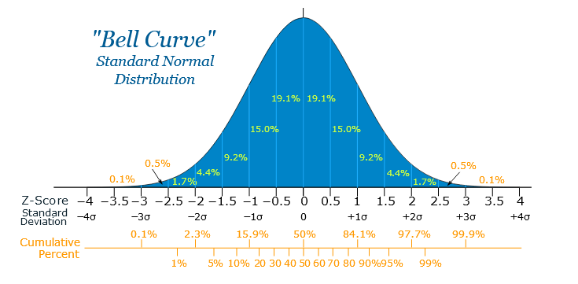
Another Example
Your score in a recent test was 0.5 standard deviations above the average, how many people scored lower than you did?

Slide 13
Confidence Interval
A confidence interval is how much uncertainty there is with any particular statistic. Confidence intervals are often used with a margin of error.
It tells you how confident you can be that the results from a poll or survey reflect what you would expect to find if it were possible to survey the entire population.

Slide 14
Confidence level vs. Confidence Interval
Confidence levels are expressed as a percentage (for example, a 95% confidence level). It means that should you repeat an experiment or survey over and over again, 95 percent of the time your results will match the results you get from a population (in other words, your statistics would be sound!).
Confidence intervals are your results which are usually numbers.

Slide 15
Real life example
The U.S. Census Bureau routinely uses confidence levels of 90% in their surveys. One survey of the number of people in poverty in 1995 stated a confidence level of 90% for the statistics “The number of people in poverty in the United States is 35,534,124 to 37,315,094.”
That means if the Census Bureau repeated the survey using the same techniques, 90 percent of the time the results would fall between 35,534,124 and 37,315,094 people in poverty. The stated figure (35,534,124 to 37,315,094) is the confidence interval.

Slide 16
Calculating confidence interval using normal distribution (z-distribution)
Sample problem: Construct a 95 % confidence interval an experiment that found the sample mean temperature for a certain city in August was 101.82, with a population standard deviation of 1.2. There were 6 samples in this experiment.
Formula x̄ ± z* σ / (√n)
Steps to solve the problem
https://youtu.be/vRtC5BEbhRM
Find alpha level
Find z-score
Calculate second part
Find the lower range
Find the upper range

Slide 17

Calculating confidence interval using t-distribution table
Sample Problem: A group of 10 foot surgery patients had a mean weight of 240 pounds. The sample standard deviation was 25 pounds. Find a confidence interval for a sample for the true mean weight of all foot surgery patients. Find a 95% CI.
Formula:
Steps to solve the problem: https://youtu.be/YbXEALO2OdM
Find degree of freedom
Find alpha level
Find t-value
Find the lower range
Find the upper range

Slide 18
Another Problem
Sample problem: Construct a 98% Confidence Interval based on the following data: 45, 55, 67, 45, 68, 79, 98, 87, 84, 82.

Slide 19
Hypothesis Testing
A hypothesis is an educated guess about something in the world around you. It should be testable, either by experiment or observation. For example:
A new medicine you think might work.
A way of teaching you think might be better.
A possible location of new species.
A fairer way to administer standardized tests.
It can really be anything at all as long as you can put it to the test.

Slide 20
Hypothesis Statement
General format:
“If I…(do this to an independent variable)….then (this will happen to the dependent variable).”
If I (give patients counseling in addition to medication) then (their overall depression scale will decrease).
If I (give exams at noon instead of 7) then (student test scores will improve).
If I (look in this certain location) then (I am more likely to find new species).
If I (make the question hard) then (I am more likely to become famous!)

Slide 21
Why is it important?
Hypothesis testing in statistics is a way for you to test the results of a survey or experiment to see if you have meaningful results.
You’re basically testing whether your results are valid by figuring out the odds that your results have happened by chance.
If your results may have happened by chance, the experiment won’t be repeatable and so has little use.

Slide 22
First Step: Formulating Null Hypothesis
Null hypothesis is always the accepted fact.
DNA is shaped like a double helix.
লেখাপড়া করে যে, গাড়ীঘোড়া চড়ে সে।
Either support or reject null hypothesis.
Null hypothesis is nullfiable (something you can reject)

Slide 23
Finding Null Hypothesis
A researcher thinks that if knee surgery patients go to physical therapy twice a week (instead of 3 times), their recovery period will be longer. Average recovery times for knee surgery patients is 8.2 weeks.
Find out the null hypothesis.

Slide 24
Finding Null Hypothesis
H₀: µ <= 8.2

Slide 25
Alternate Hypothesis
A researcher thinks that if knee surgery patients go to physical therapy twice a week (instead of 3 times), their recovery period will be longer. Average recovery times for knee surgery patients is 8.2 weeks.
H₀: µ <= 8.2
Find out the alternate hypothesis.

Slide 26
Alternate Hypothesis
H₀: µ <= 8.2
H₁: µ > 8.2 (alternate hypothesis)

Slide 27

Hypothesis Testing Example
Problem: A principal at a certain school claims that the students in his school are above average intelligence. A random sample of thirty students IQ scores have a mean score of 112. Is there sufficient evidence to support the principal’s claim? The mean population IQ is 100 with a standard deviation of 15.
Formula to find the test statistics:
If z-score from test statistics is greater than the rejection area from z-table, reject the null hypothesis
State the Null Hypothesis
State the Alternate Hypothesis
State the alpha level
Find the rejection area from z-table
Find the test statistics
Support or Reject Null Hypothesis

Slide 28
Hypothesis Testing Example (two-tailed test)
Blood glucose levels for obese patients have a mean of 100 with a standard deviation of 15. A researcher thinks that a diet high in raw cornstarch will have a positive or negative effect on blood glucose levels. A sample of 30 patients who have tried the raw cornstarch diet have a mean glucose level of 140. Test the hypothesis that the raw cornstarch had an effect.
This is a two-tailed test. (null hypothesis involves equality)
https://youtu.be/aiRVUkM92os

Slide 29
References
https://www.mathsisfun.com/data/standard-normal-distribution.html
http://www.statisticshowto.com/inferential-statistics/
https://www.coursera.org/learn/inferential-statistics
http://www.statisticshowto.com/probability-and-statistics/confidence-interval/
http://www.statisticshowto.com/probability-and-statistics/hypothesis-testing/

